Slide 1
Week 10
Designing Interfaces

Slide 2
Introduction
Defining the manner in which humans and computers exchange inform
Interface design – focuses on how information is provided to and captured from users

Slide 3
Interface Designs
User-focused activity
Prototyping methodology of iteratively:
  Collecting information
  Constructing a prototype
  Assessing usability
  Making refinements
Must answer the who, what, when, where, and how questions

Slide 4
Interaction Methods and Devices
Interface – method by which users interact with an information system
All human-computer interfaces must:
  have an interaction style
  use some hardware device(s) for supporting this interaction

Slide 5
Methods of Interacting
Five widely used styles of interacting include:
  Command line
    Includes keyboard shortcuts and function keys
  Menu
  Form
  Object-based
  Natural language

Slide 6
Command Language Interaction
Command language interaction – human-computer interaction method whereby users enter explicit statements into a system to invoke operations
Example from Linux command prompt:
  $ cp file.doc newfile.doc
  Makes a copy of file.doc and names it newfile.doc
  The dollar sign is the command prompt from Linux, not part of the command itself

Slide 7
Menu Interaction
11.2 Contrast and apply several methods for interacting with a system
Menu interaction – human–computer interaction method in which a list of system options is provided and a specific command is invoked by user selection of a menu option
  Menus can differ significantly in design and complexity
  Larger systems might use menu hierarchies providing navigation
  Variation in menu arrangement can greatly influence system usability

Slide 8
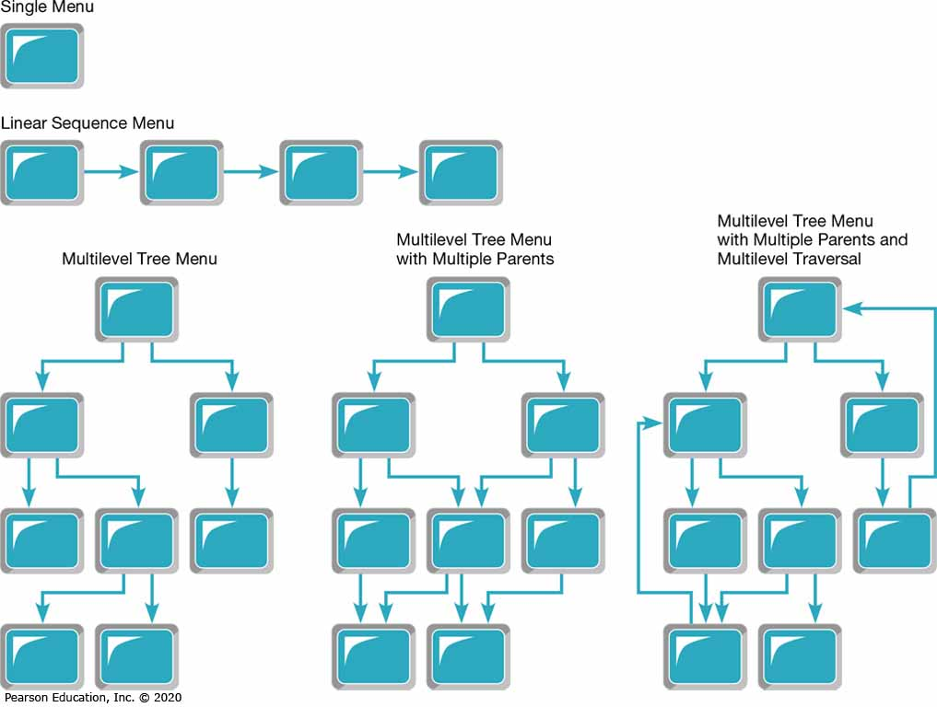
Figure 1: Various Types of Menu Configurations
(Source: Based on Shneiderman et al., 2016)

Slide 9
Pop-up Menu
11.2 Contrast and apply several methods for interacting with a system
Pop-up menu – menu-positioning method that places a menu near the current cursor position
  Also called a dialogue box
  Users don’t have to move their position or eyes to view system options
Drop-down menu – menu-positioning method that places the access point of the menu near the top line of the display; when accessed, menus open by dropping down onto the display

Slide 10
Table 1: Guidelines for Menu Design
Wording | • Each menu should have a meaningful title. • Command verbs should clearly and specifically describe operations. • Menu items should be displayed in mixed uppercase and lowercase letters and have a clear, unambiguous interpretation.
Organization | • A consistent organizing principle should be used that relates to the tasks the intended users perform; for example, related options should be grouped together, and the same option should have the same wording and codes each time it appears.
Length | • The number of menu choices should not exceed the length of the screen. • Submenus should be used to break up exceedingly long menus.
Selection | • Selection and entry methods should be consistent and reflect the size of the application and sophistication of the users. • How the user is to select each option and the consequences of each option should be clear (e.g., whether another menu will appear).
Highlighting | • Highlighting should be minimized and used only to convey selected options (e.g., a check mark) or unavailable options (e.g., dimmed text).

Slide 11
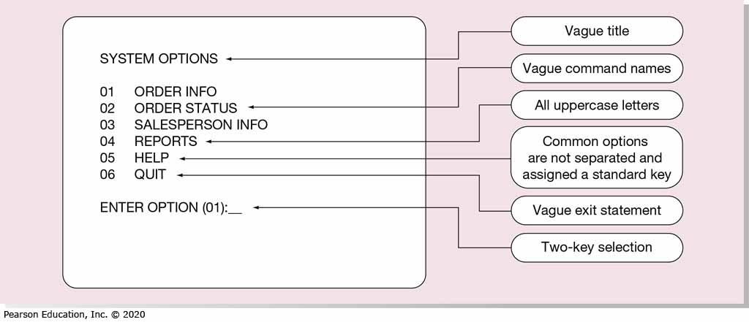
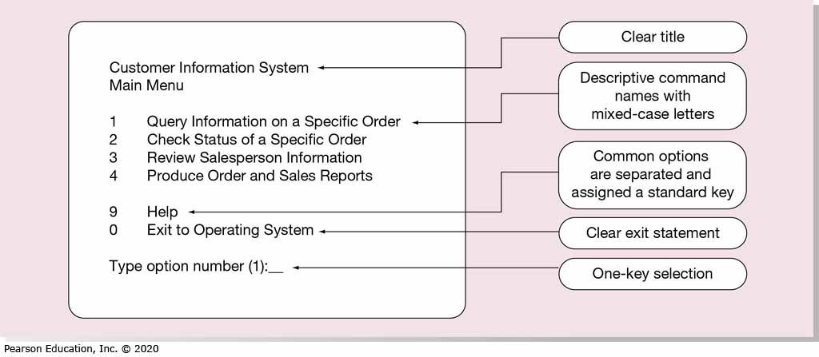
Figure 2:Contrasting Menu Designs (a) Poor Menu Design (b) Improved Menu Design

Slide 12
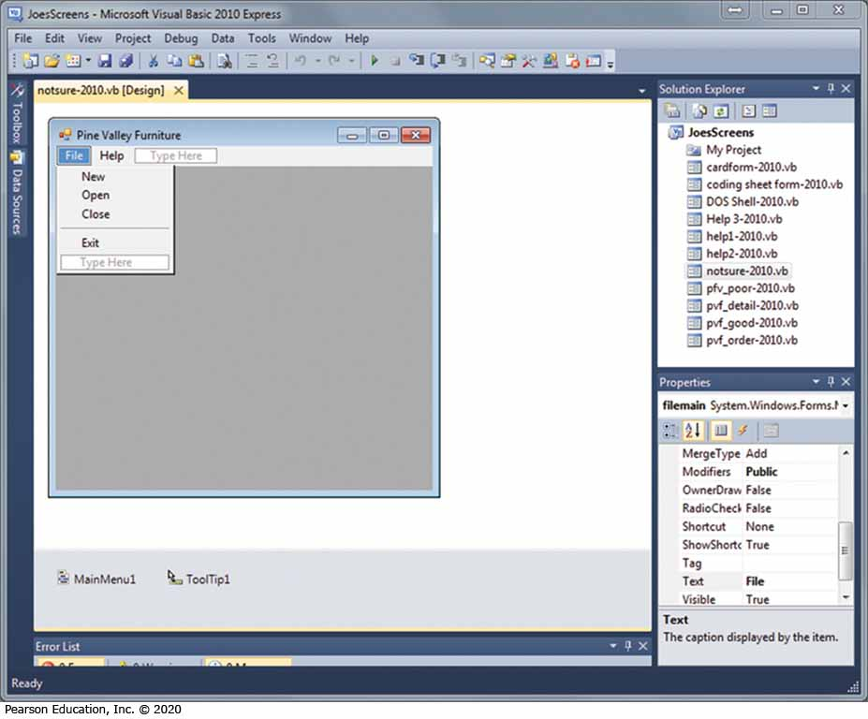
Figure 3: Menu Building with Microsoft Visual Basic.NET
(Source: Microsoft Corporation)

Slide 13
Form Interaction
Form interaction – highly intuitive human-computer interaction method whereby data fields are formatted in a manner similar to paper-based forms
  Allows users to fill in the blanks when working with a system

Slide 14
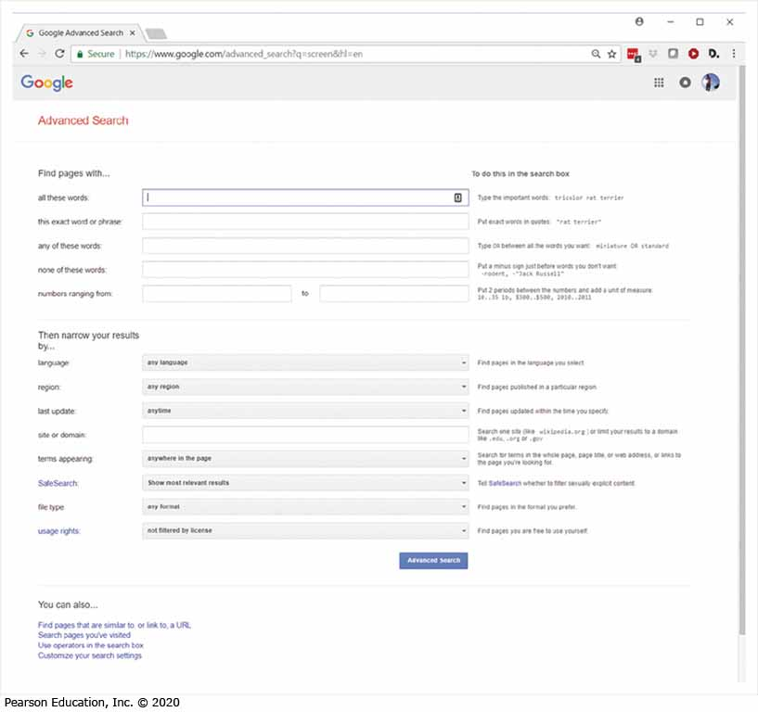
Figure 4: Example of Form Interaction from the Google Advanced Search Engine
(Source: Google, Inc.)

Slide 15
Object-Based Interaction
11.2 Contrast and apply several methods for interacting with a system
Object-based interaction – human-computer interaction method in which symbols are used to represent commands or functions
Icon – graphical picture that represents specific functions within a system
  Take up little screen space
  Quickly understood by most users

Slide 16
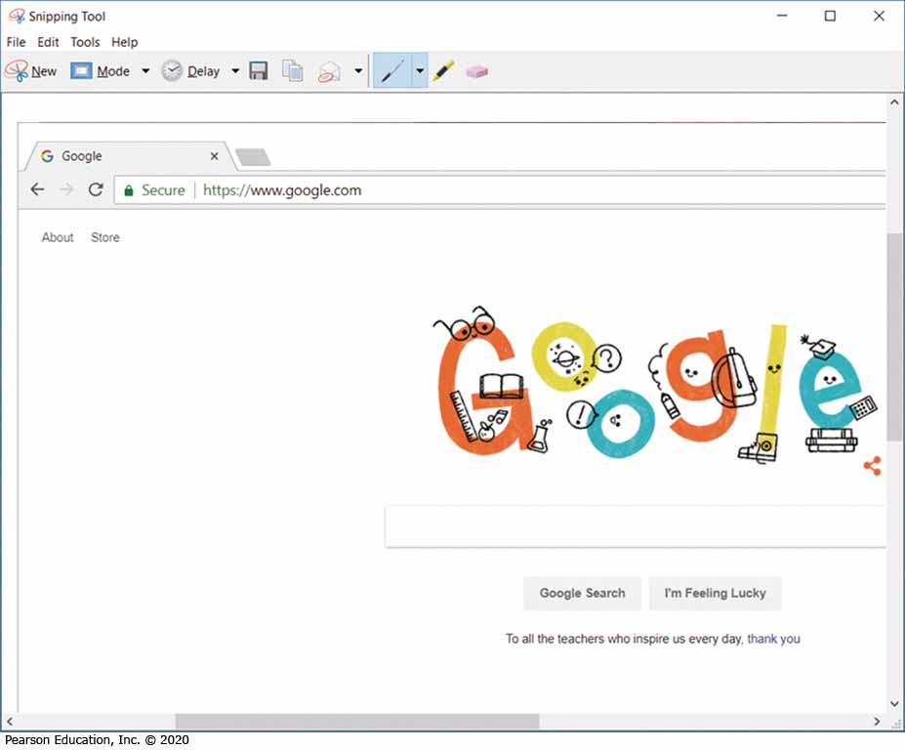
Figure 5: Object-Based (Icon) Interface from Microsoft’s Snipping Tool
(Source: Microsoft Corporation)

Slide 17
Natural Language Interaction
Natural language interaction – human-computer interaction method whereby inputs to and outputs from a computer-based application are in a conventional spoken language such as English
  Based on research in artificial intelligence
  Current implementations are tedious and difficult to work with, not as viable as other interaction methods

Slide 18
Hardware Options for System Interaction
A growing number of hardware devices are employed to support human-computer interaction
Selection of an interaction device must be selected during the logical design phase
To design the most effective interfaces you need to understand the capabilities of the various methods and devices

Slide 19
Table 2: Common Devices for Interacting with an Information System
Device | Description and Primary Characteristics or Usage
Keyboard | Users push an array of small buttons that represent symbols that are then translated into words and commands. Keyboards are widely understood and provide considerable flexibility for interaction.
Mouse | A small plastic box that users push across a flat surface and whose movements are translated into cursor movement on a computer display. Buttons on the mouse tell the system when an item is selected. A mouse works well on flat desks but may not be practical in dirty or busy environments, such as a shop floor or check-out area in a retail store. Newer pen-based mice provide the user with more of the feel of a writing implement.
Joystick | A small vertical lever mounted on a base that steers the cursor on a computer display. Provides similar functionality to a mouse.
Trackball | A sphere mounted on a fixed base that steers the cursor on a computer display. A suitable replacement for a mouse when work space for a mouse is not available.
Touch Screen | Selections are made by touching a computer display. This works well in dirty environments or for users with limited dexterity or expertise.
Light Pen | Selections are made by pressing a pen-like device against the screen. A light pen works well when the user needs to have a more direct interaction with the contents of the screen.
Graphic Tablet | Moving a pen-like device across a flat tablet steers the cursor on a computer display. Selections are made by pressing a button or by pressing the pen against the tablet. This device works well for drawing and graphical applications.
Voice | Spoken words are captured and translated by the computer into text and commands. This is most appropriate for users with physical challenges or when hands need to be free to do other tasks while interacting with the application.

Slide 20
Designing Interfaces
Should use standard forms for forms/reports
Typical paper based form has several common general areas such as:
  Header information
  Sequence and time-related information
  Instruction or formatting information
  Body or data details
  Totals or data summary
  Authorization or signatures
  Comments

Slide 21
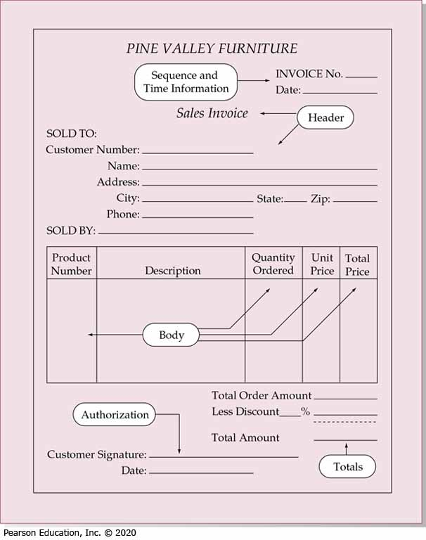
Figure 6: Paper-Based Form for Reporting Customer Sales Activity (Pine Valley Furniture)

Slide 22
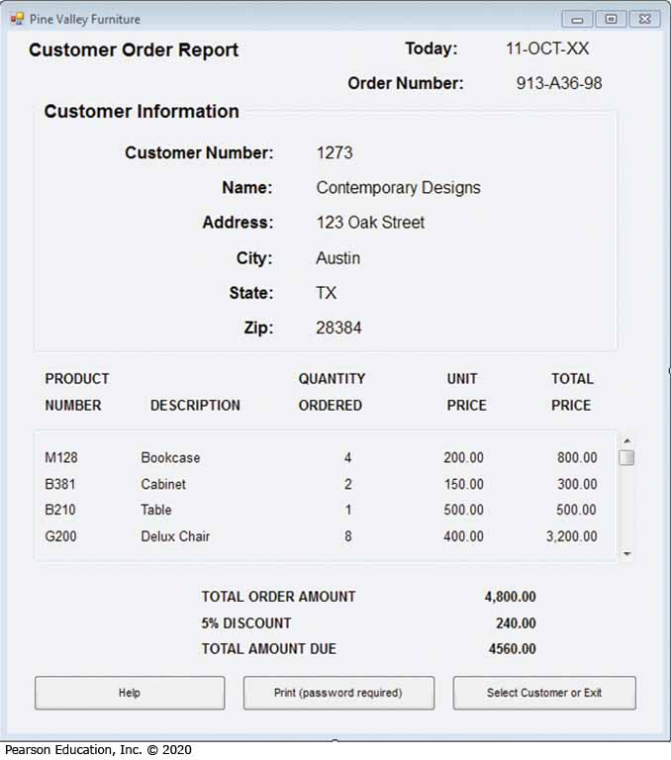
Figure 7: Computer-Based Form Reporting Customer Sales Activity (Pine Valley Furniture)
(Source: Microsoft Corporation)

Slide 23
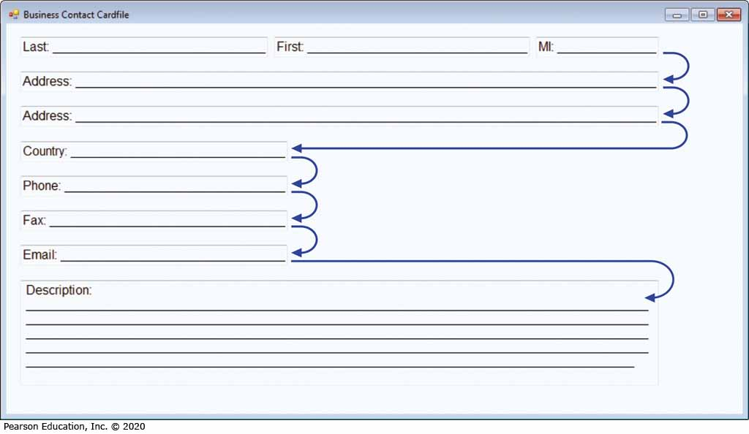
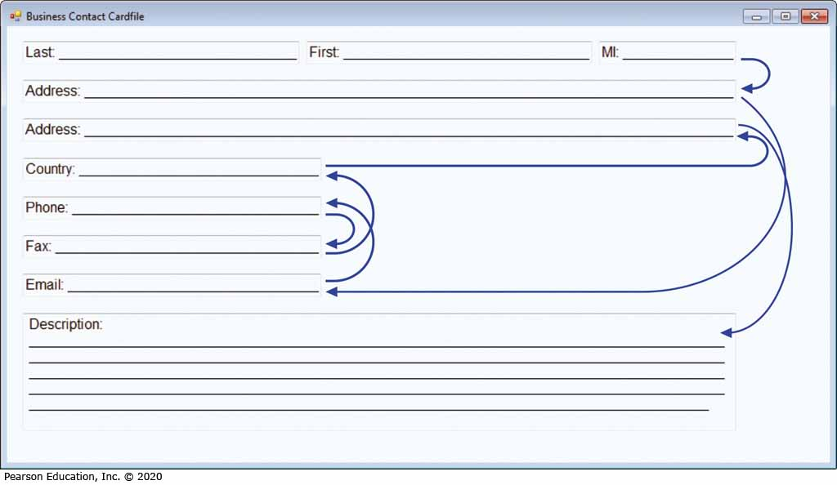
Figure 8: Contrasting the Navigation Flow Within a Data Entry Form (a) Proper Flow Between Data Entry Field (b) Poor Flow Between Data Entry Fields

Slide 24
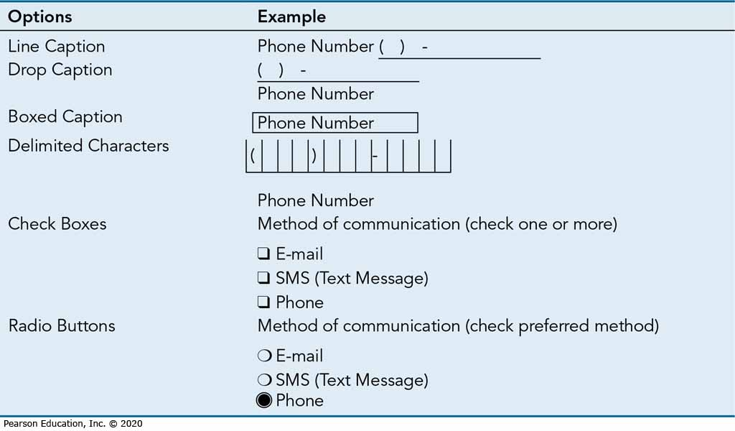
Table 3: Options for Entering or Selecting Text

Slide 25
Table 4: Validation Tests and Techniques to Enhance the Validity of Data Input
Validation Test | Description
Class or Composition | Test to ensure that data are of proper type (e.g., all numeric, all alphabetic, all alphanumeric)
Combinations | Test to see if the value combinations of two or more data fields are appropriate or make sense (e.g., Does the quantity sold make sense given the type of product?)
Expected Values | Test to see if data are what is expected (e.g., match with existing customer names, payment amount, etc.)
Missing Data | Test for existence of data items in all fields of a record (e.g., Is there a quantity field on each line item of a customer order?)
Pictures/Templates | Test to ensure that data conform to a standard format (e.g., Are hyphens in the right places for a student ID number?)
Range | Test to ensure data are within proper range of values (e.g., Is a student’s grade point average between 0 and 4.0?)
Reasonableness | Test to ensure data are reasonable for situation (e.g., pay rate for a specific type of employee)
Self-Checking Digits | Test where an extra digit is added to a numeric field in which its value is derived using a standard formula (see Figure 11-14)
Size | Test for too few or too many characters (e.g., Is social security number exactly nine digits?)
Values | Test to make sure values come from set of standard values (e.g., two-letter state codes)

Slide 26
Providing Feedback
11.3 Describe and apply the general guidelines for designing interfaces and specific guidelines for layout design, structuring data entry fields, providing feedback, and system help
Three types of system feedback:
  Status information: keep user informed of what’s going on, helpful when user has to wait for response
  Prompting cues: tell user when input is needed, and how to provide the input
  Error or warning messages: inform user that something is wrong, either with data entry or system operation

Slide 27
Table 5: Examples of Poor and Improved Error Messages
Poor Error Messages | Improved Error Messages
ERROR 56 OPENING FILE | The file name you typed was not found. Press F2 to list valid file names.
WRONG CHOICE | Please enter an option from the menu.
DATA ENTRY ERROR | The prior entry contains a value outside the range of acceptable values. Press F9 for list of acceptable values.
FILE CREATION ERROR | The file name you entered already exists. Press F10 if you want to overwrite it. Press F2 if you want to save it to a new name.

Slide 28
Table 6: Common Errors When Designing the Interface of Websites
Error | Description
Opening New Browser Window | Avoid opening a new browser window when a user clicks on a link unless it is clearly marked that a new window will be opened; users may not see that a new window has been opened, which will complicate navigation, especially moving backward.
Breaking or Slowing Down the Back Button | Make sure users can use the back button to return to prior pages. Avoid opening new browser windows, using an immediate redirect where, when users click the back button, they are pushed or forward to an undesired location.
Complex URLs | Avoid overly long and complex URLs because it makes it more difficult for users to understand where they are and can cause problems if users want to e-mail page locations to colleagues.
Orphan Pages | Avoid having pages with no “parent” that can be reached by using a back button; requires users to “hack” the end of the URL to get back to some other prior page.
Scrolling Navigation Pages | Avoid placing navigational links below where a page opens because many users may miss these important options that are below the opening window.
Lack of Navigation Support | Make sure your pages conform to users’ expectations by providing commonly used icon links such as a site logo at the top or other major elements. Also place these elements on pages in a consistent manner.
Hidden Links | Make sure you leave a border around images that are links, don’t change link colors from normal defaults, and avoid embedding links within long blocks of text.
Links That Don’t Provide Enough Information | Avoid not turning off link-marking borders so that links clearly show which links users have clicked and which they have not. Make sure users know which links are internal anchor points versus external links, and indicate if a link brings up a separate browser window from those that do not. Finally, make sure link images and text provide enough information to users so that they understand the meaning of the link.
Buttons That Provide No Click Feedback | Avoid using image buttons that don’t clearly change when being clicked; use Web GUI toolkit buttons, HTML form-submit buttons, or simple textual links.

